Slide 1
Kent Ridge Catchment
An experimental catchment set up to better understand the hydrological rainfall-runoff processes in an urban tropical environment through a deeper insight into hydrograph flow components and runoff response of specific land use types.

Slide 2
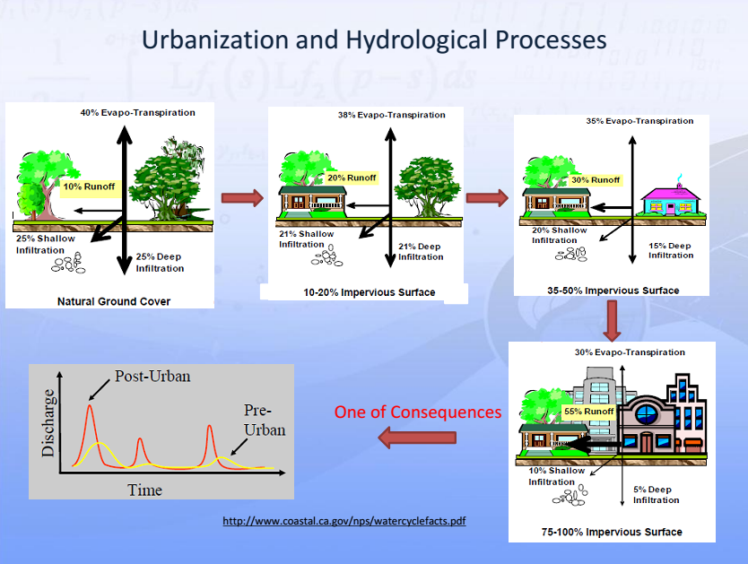
Motivation

Slide 3
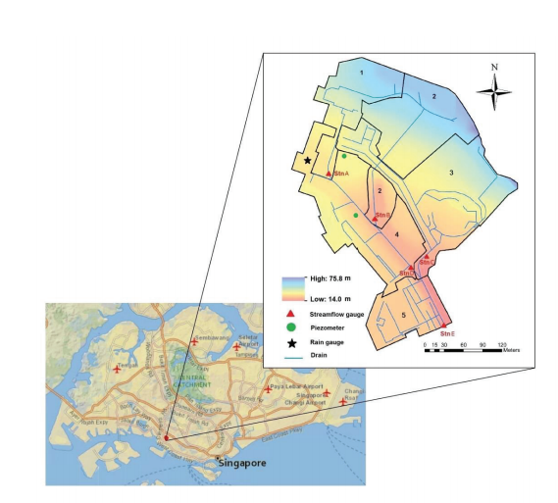
Introduction
Size: 8.5 ha
Located within the National University of Singapore

Slide 4
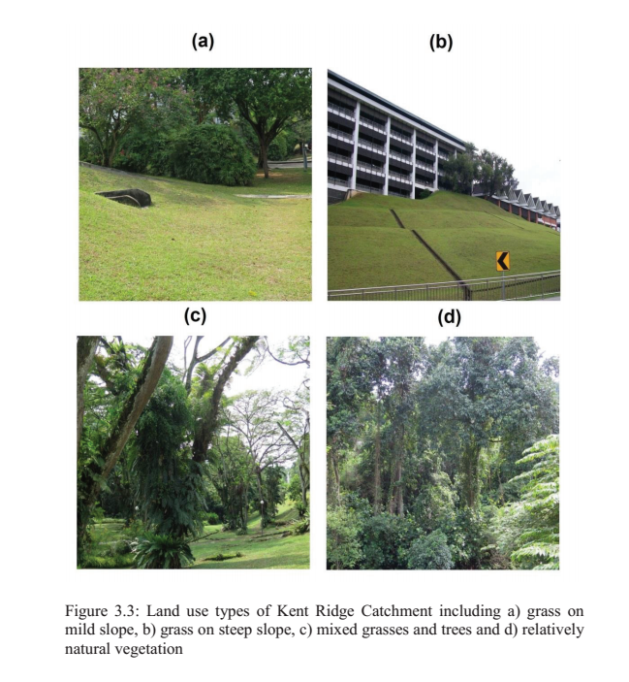
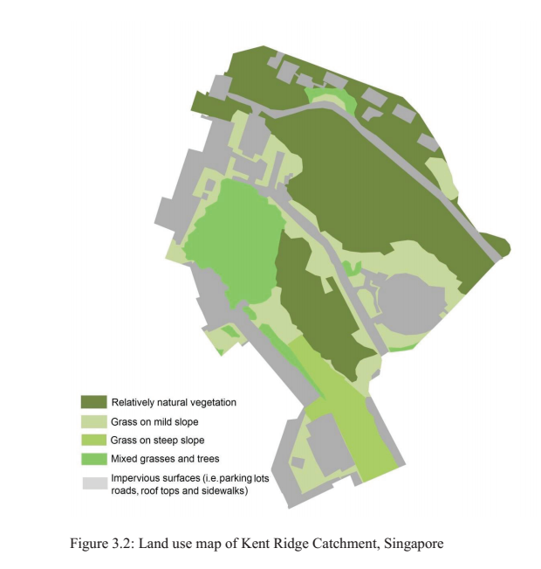
Land Use- Kent Ridge Catchment
Consists of all main landuse types of Singapore
Considered representative from a hydrological point of view

Slide 5
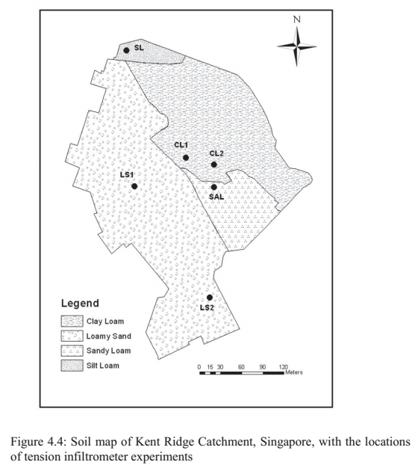
Soil Map
Main Soil Types:
Clay Loam
Loamy Sand
Sandy Loam
Silt Loam

Slide 6
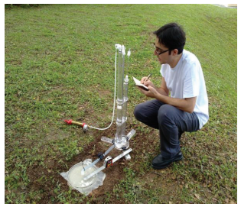
Monitoring Network
5 Rainfall Stations
14 Water level Stations
Groundwater measurements
Infiltration measurements
Canopy Storage

Slide 7
Walk through the catchcment

Slide 8
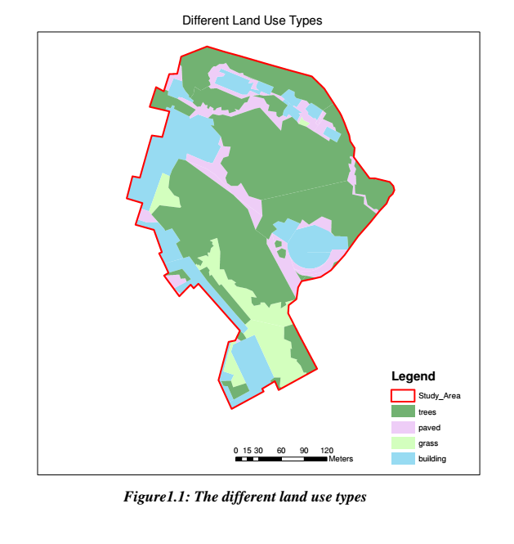
Landuse:
Buildings
Paved Areas
Grass
Trees/Shrubs

